Slide 1
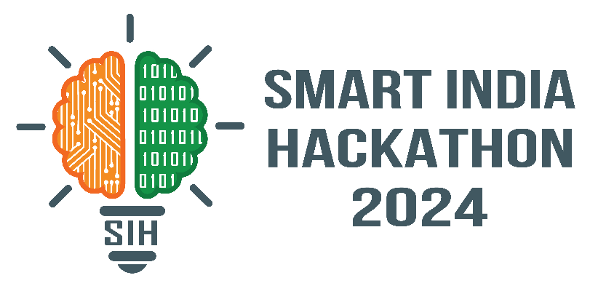
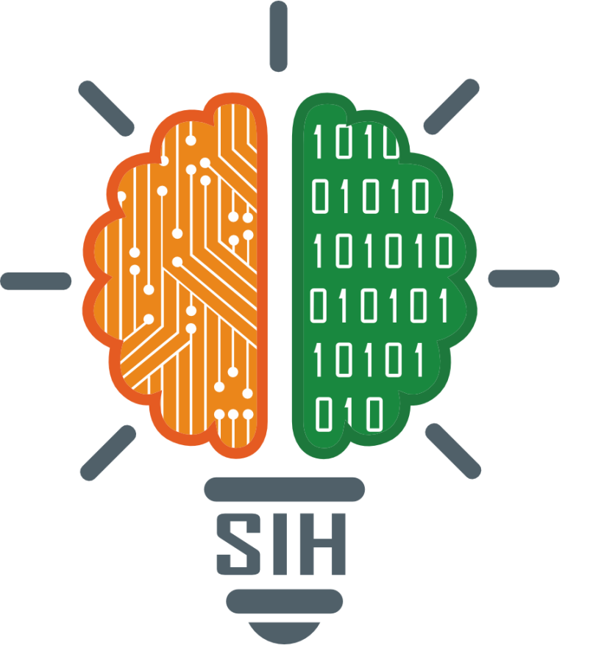
SMART INDIA HACKATHON 2024
Problem Statement ID - 1631
Problem Statement Title – Student assistance chatbot
Theme – Smart education
PS Category- Software
Team Name - Cookie-bots

Slide 2
CHATBOT BASED TICKETING SYSTEM
Proposed Solution
AI-Powered Chatbot:
Automates ticket booking and management.
Available on museum’s website website.
User Interaction:
Easy booking through an intuitive chatbot interface.
Guides visitors through date selection, payment, and confirmation.
Real-Time Updates:
Instant booking confirmations and updates.
Error-free ticket management and synchronization with museum systems.
How it addresses the problem
Reduces Wait Times:
Eliminates long queues and delays.
Minimizes Errors:
Prevents double bookings and incorrect ticket issuance.
Enhances Visitor Satisfaction:
Provides a smooth, hassle-free booking experience.
Streamlines Operations:
Frees up staff from manual ticketing tasks.

Slide 3
TECHNICAL APPROACH
Technologies to be Used
Front-end
React.js: For responsive, interactive UI
Tailwind CSS: For styling and layout
Back-end
Node.js with Express.js: To handle API requests and server-side logic
Chatbot
OpenAI API: For chatbot AI and natural language processing (NLP)
Database
MongoDB: For data storage (tickets, users, bookings)
Payment Integration
Stripe: Secure online payment processing
System Workflow
User Interaction: Visitors chat with AI on website for ticket booking
NLP: OpenAI API processes and responds to user queries
Database Access: Fetches available tickets and info from the database.
Payment Gateway: Users complete transactions via Stripe.
Ticket Generation: QR code ticket sent via email/SMS.
On-site Validation: Tickets scanned at museum entrance for entry

Slide 4
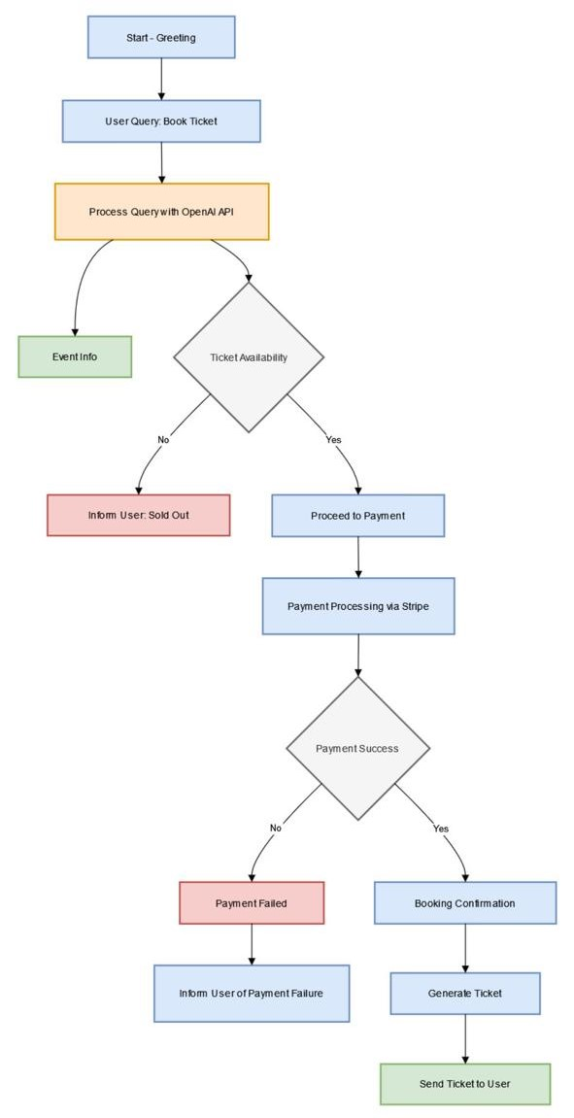
FEASIBILITY AND VIABILITY
Feasibility of the Idea
Technical Feasibility:
The MERN stack is suitable for developing a robust backend and frontend for the chatbot system.
Feasible to integrate various chatbot frameworks or APIs with existing technologies.
Resource Availability:
Team’s expertise in MERN stack aligns well with project requirements.
Availability of chatbot development tools and platforms that support integration with the chosen stack.

Slide 5
IMPACT AND BENEFITS
Potential Impact on the Target Audience
Improved User Experience: Faster, error-free ticketing process for museum visitors.
Increased Efficiency: Reduces wait times and manual errors, enhancing overall satisfaction.
Enhanced Engagement: Interactive chatbot can provide additional information and recommendations.
Benefits of the Solution
Social: Enhances visitor experience and engagement.
Economic: Reduces operational costs for museums; increases ticket sales efficiency.
Environmental: Minimizes paper use by moving to digital ticketing.

Slide 6
RESEARCH AND REFERENCES
[1] S. A. and D. John, “Survey on Chatbot Design
Techniques in Speech Conversation Systems,” Int. J.
Adv. Comput. Sci. Appl., vol. 6, no. 7, 2015.
[2]. Garcia, L. (2020). "Applications of Chatbots
and Virtual Assistants in the Tourism Sector:
A Comprehensive Review." Journal of
Tourism Research, 18(3), 211-228. DOI:
10.7890/jtr.2020.12345678
[3]. Book: "Speech and Language Processing" by Daniel Jurafsky and James H. Martin
A comprehensive book on NLP that covers speech recognition, text processing, and dialogue systems.

